Slide 1
Airline Safety from 1985 to 2014

Slide 2
Introduction
Overview
Airline safety data from 1985-2014 representing 56 airlines worldwide
Events are categorized into incidents, fatal accidents, and fatalities
Target Audience
The air traveler

Slide 3
Business Problems
What significant information can be gathered from past airline incidents or accidents?
Can a traveler who is concerned about safety make a decision about which airline to use from past airline safety data?

Slide 4
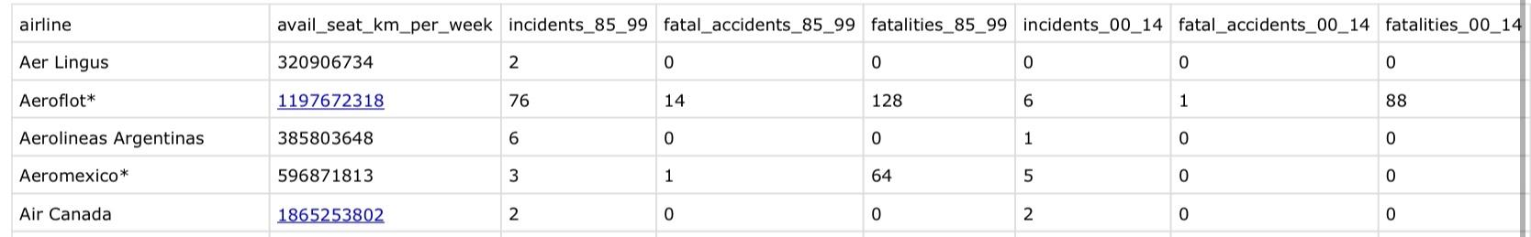
Data
Airline safety was from the period 1985 to 2014 and was from the url link below:
https://raw.githubusercontent.com/fivethirtyeight/data/master/airline-safety/airline-safety.csv
Part of Data Table Output
Figure 1: Part of Data Table Output

Slide 5
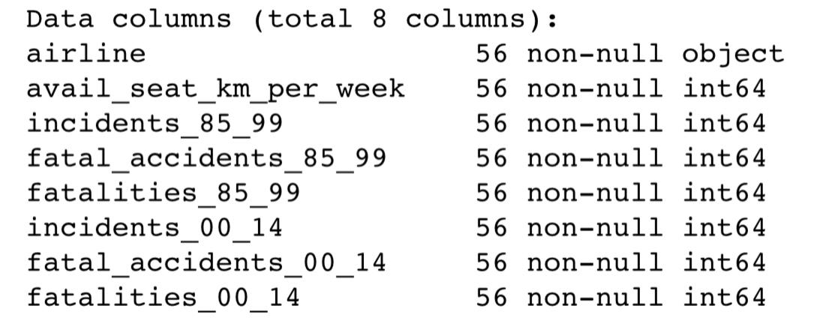
Data
8 columns
7 integer features and 1 categorical feature
8 total features
56 airlines worldwide
Data Columns Output

Slide 6
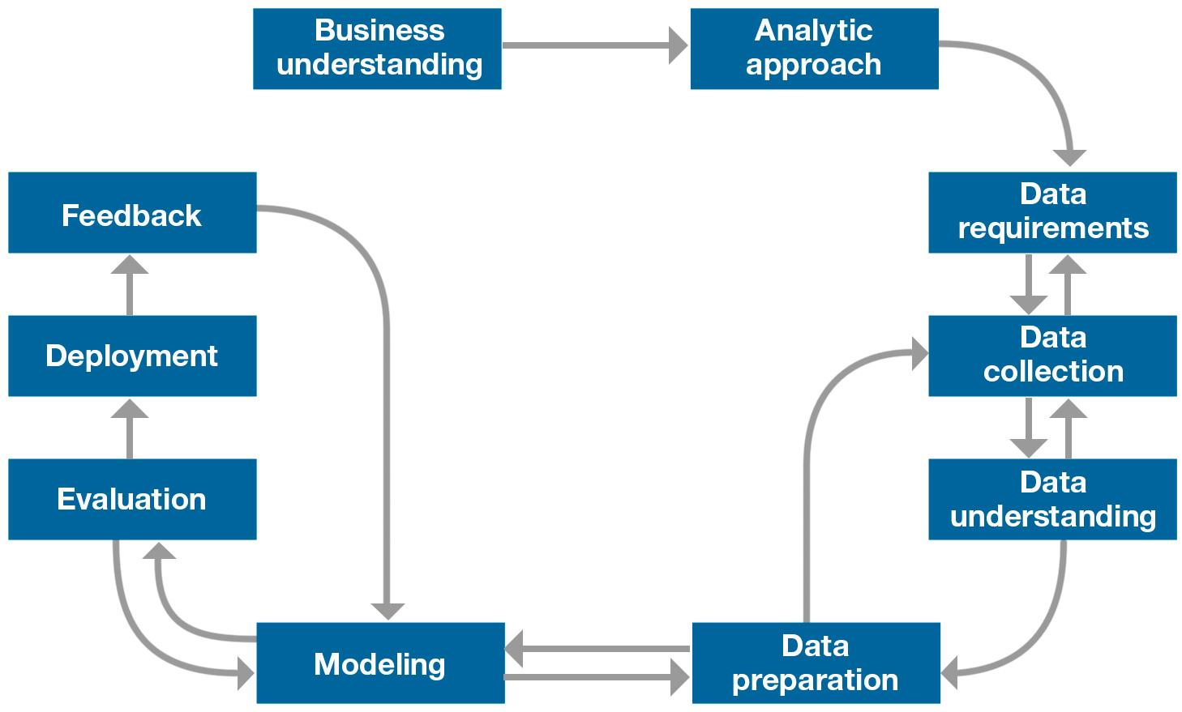
Methodology
-A Jupyter notebook was created in IBM Watson Studio using Python programming language
-NumPy, pandas, plotly, seaborn, Matplotlib were imported
-Various functions were used: info ( ), describe ( ), nunique ( ), min / max, etc.
-A heat map was generated
-Model/code created for a tool that could count incidents, fatal accidents, and fatalities
IBM Foundational methodology for data science

Slide 7
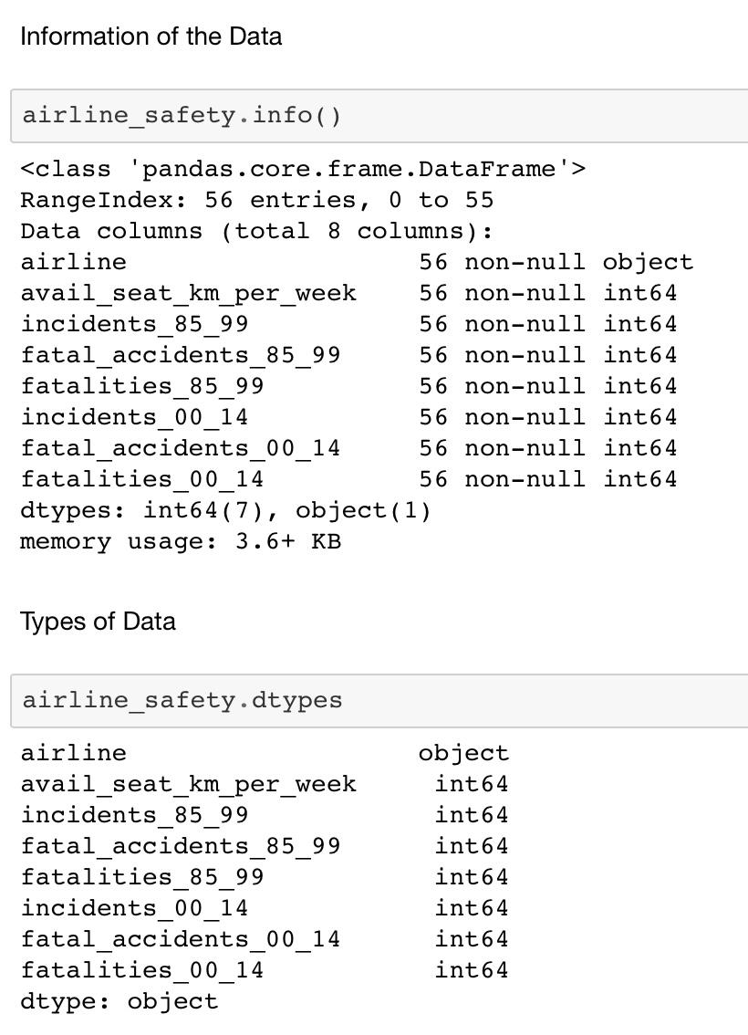
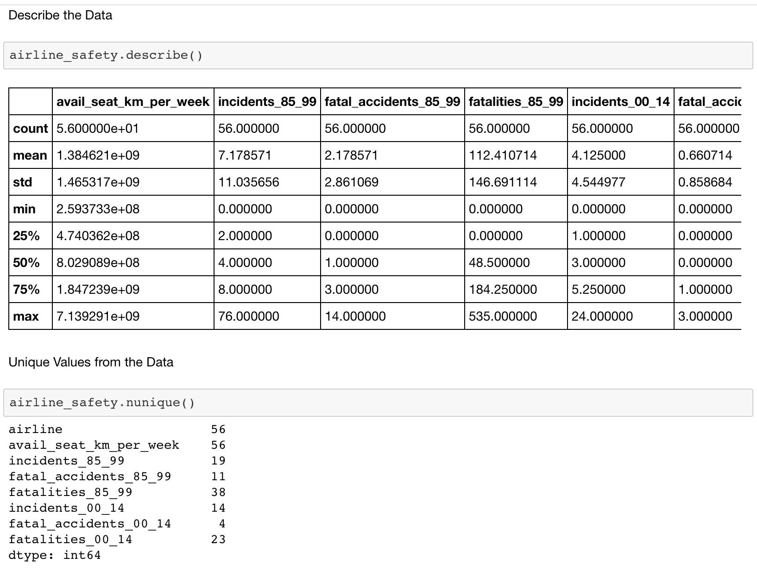
Methodology

Slide 8
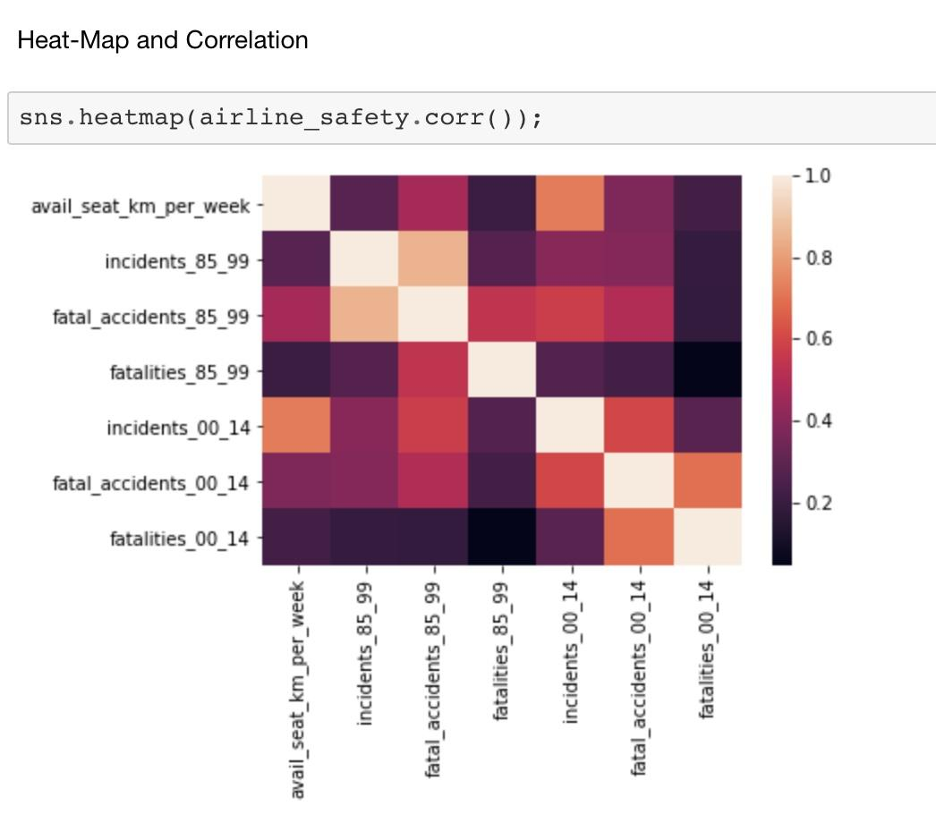
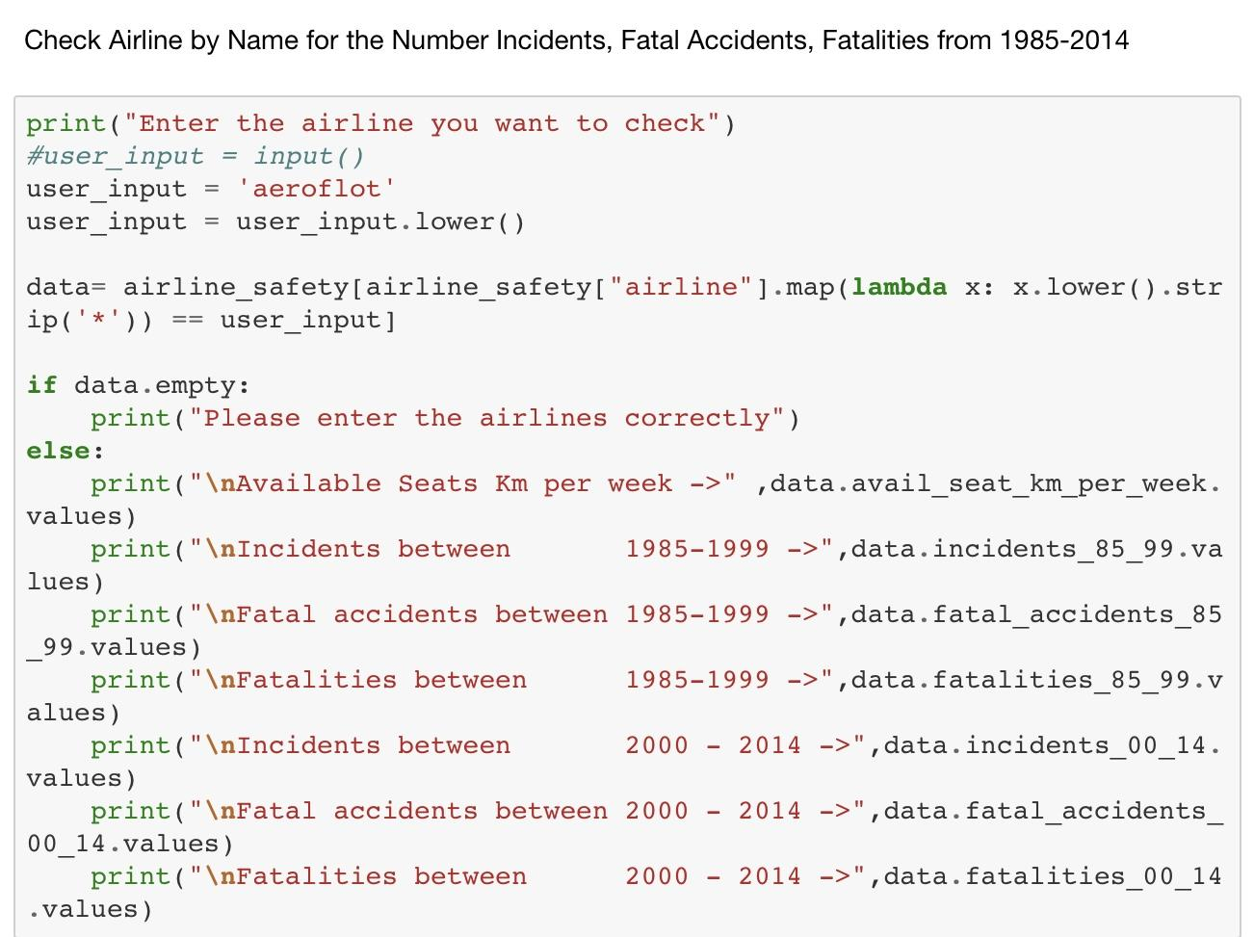
Methodology

Slide 9
Results
-Between 1985-1999 the average airline incidents was 7, the average fatal accidents was 2, and the average fatalities was 112.
-Between 2000-2014 the average airline incidents was 4, the average fatal accidents was less than 1, and average fatalities was 55.
-There were more airline incidents, fatal accidents, and fatalities than in comparison to the period of time from 2000-2014.
-The heat-map visualization displays a high intensity of value for fatalities.

Slide 10
Results
-TAP - Air Portugal reported 0 incidents, fatal accidents, and fatalities for the time periods 1985-1999 and 2000-2014.
-Aeroflot recorded the most incidents 82 in total for the time periods 1985-1999 and 2000-2014.
-Malaysia Airlines recorded the most fatalities at 571 for the time periods 1985-1999 and 2000-2014.

Slide 11
Discussion
The time period of 2000-2014 had lower incidents, fatal accidents, and fatalities in comparison to the time period 1985-1999 perhaps a result of technological advances in airplanes, enhanced flight crew training, airplanes that are newer, etc.
Further Considerations
1.) An airline may not fly a specific route to a destination.
2.) An airline may have more flights than another airline.
3.) The reason (e.g. weather, human error, etc.) for the airplane accident/ incident.
4.) What is the impact on the airline’s reputation?

Slide 12
Conclusion
This project demonstrates that it is both possible to find significant information from past airline incidents and a traveler can make a more informed decision about which airlines he/she should use for air travel.

